Slide 1
Cucumber BDD

Slide 2
What is BDD?
Behaviour-Driven Development
BDD is one of the development approach involves the usage of common language that enhances communication between various tech and non-tech teams. Tests are more user-focused and based on the system's behavior. In BDD, "Given-When-Then" is the proposed approach for writing test cases.
Sample
Given I am at landing page of Ecommerce application ->
When I searched for product which does not exist
Then No results message should be displayed

Slide 3
Difference between Cucumber & Selenium
Cucumber:
Tool/Framework that supports BDD.
Difference between Cucumber & Selenium
Selenium is the tool to design web Automation tests,
Cucumber helps to design Framework for Selenium Automation tests written in BDD standard

Slide 4
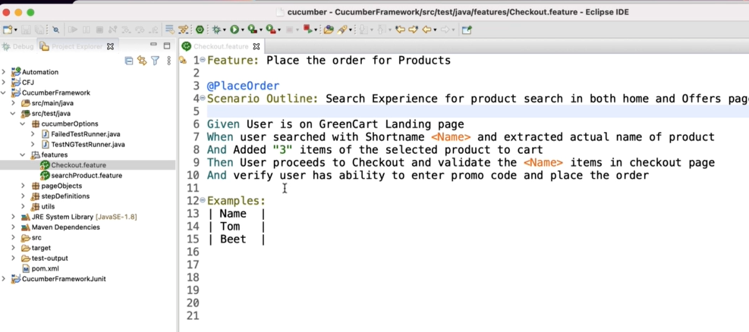
Sample Cucumber feature

